Slide 1
Optimization Techniques
Shivam Gaind

Slide 2
Background
What is Optimization?
Start with an initial design
Define a goal (ex. maximize gain, minimize weight)
Add constraints (ex. size limits, material limits)
Run loop (design is continuously improved)
Stops once convergence occurs (ex. gain is no longer improved, weight is no longer reduced)
What is Parameter Sweep?
Often used before Optimization
Choose a parameter (permittivity)
Test different values
Goal is to identify trends within the material (plot gain vs. permittivity)

Slide 3
Background
Local Optimization
Start with an initial design
Calculates value for goal (ex. gain, weight)
Changes parameter that improves it
Repeats until local optimum has been reached (value is no longer improved)
Global Optimization (slow)
Uses multiple designs
Best designs are kept
New designs are created by crossing over best designs
Loop runs until improvement becomes marginal
Topology Optimization
Starts with a single design
Design is continuously improved
Produce a single final optimized design

Slide 4
Articles

Slide 5
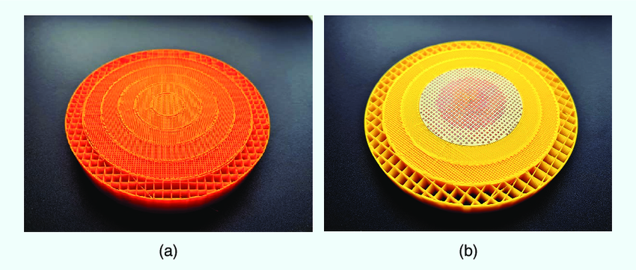
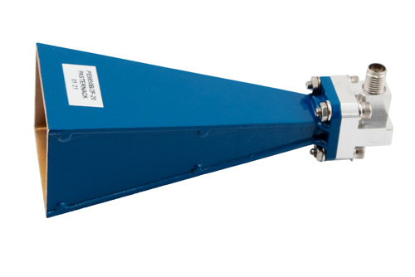
Adjoint Sensitivity Optimization of Three-Dimensional Directivity-Enhancing, Size-Reducing GRIN Lenses
General Notes
Introduces a new way to design lenses for antennas that improves gain without making the antennas larger
GRIN Lenses are made from a single material but the internal structure changes.
Variations of structure within the lens are used to bend waves
Key Findings
Result: The GRIN lens antenna system preformed similarly to a 20 dB horn antenna (much larger in size)
E. B. Whiting et al., "Adjoint Sensitivity Optimization of Three-Dimensional Directivity-Enhancing, Size-Reducing GRIN Lenses," in IEEE Antennas and Wireless Propagation Letters, vol. 21, no. 11, pp. 2166-2170, Nov. 2022, doi: 10.1109/LAWP.2022.3182900.
keywords: {Lenses;Permittivity;Optimization;Three-dimensional displays;Gain;Electric fields;Computational modeling;Additive manufacturing;gradient optimization;gradient Index (GRIN);inverse design},

Slide 6
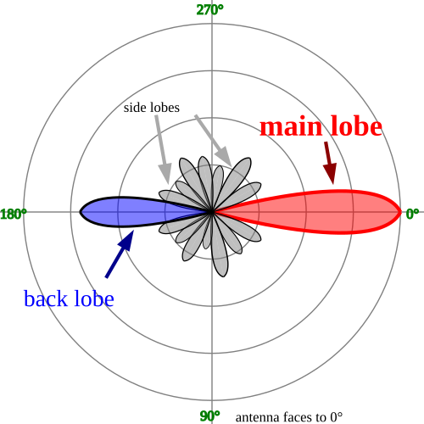
Adjoint Sensitivity Optimization of Three-Dimensional Directivity-Enhancing, Size-Reducing GRIN Lenses
What is Gain?
Gain (dB) is a measure of how strong the antennas signal is
  0 dB: spreads power equally in all directions (theoretical)
  10 dB: 10× stronger in one direction
  20 dB: 100× stronger in one direction
Benefits of GRIN Lenses
Increases gain (creates a stronger and more focused signal)
Reduces sidelobes
Makes the antenna smaller
E. B. Whiting et al., "Adjoint Sensitivity Optimization of Three-Dimensional Directivity-Enhancing, Size-Reducing GRIN Lenses," in IEEE Antennas and Wireless Propagation Letters, vol. 21, no. 11, pp. 2166-2170, Nov. 2022, doi: 10.1109/LAWP.2022.3182900.
keywords: {Lenses;Permittivity;Optimization;Three-dimensional displays;Gain;Electric fields;Computational modeling;Additive manufacturing;gradient optimization;gradient Index (GRIN);inverse design},

Slide 7
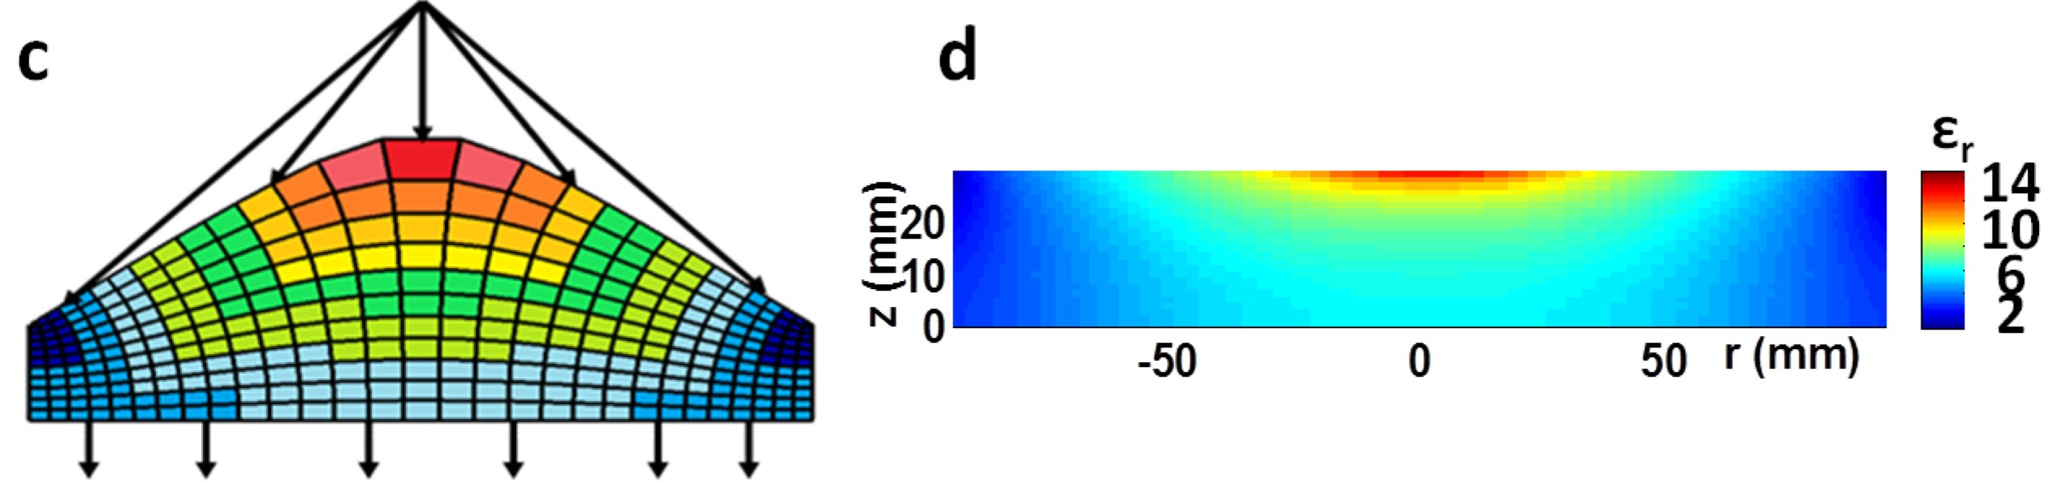
Adjoint Sensitivity Optimization of Three-Dimensional Directivity-Enhancing, Size-Reducing GRIN Lenses
How are GRIN lenses designed?
  Transformation Optics
  (used for designing 2D GRIN Lenses)
    Start with an existing lens
    Apply a coordinate transformation so that the electromagnetic waves behave as if space is bent
    Derive the material properties that you need from that equation
    Build the lens using those material properties
Limitations
Often produces anisotropic materials, or materials with extremely high permittivity values
We want GRIN lenses to be easily fabricated
E. B. Whiting et al., "Adjoint Sensitivity Optimization of Three-Dimensional Directivity-Enhancing, Size-Reducing GRIN Lenses," in IEEE Antennas and Wireless Propagation Letters, vol. 21, no. 11, pp. 2166-2170, Nov. 2022, doi: 10.1109/LAWP.2022.3182900.
keywords: {Lenses;Permittivity;Optimization;Three-dimensional displays;Gain;Electric fields;Computational modeling;Additive manufacturing;gradient optimization;gradient Index (GRIN);inverse design},

Slide 8
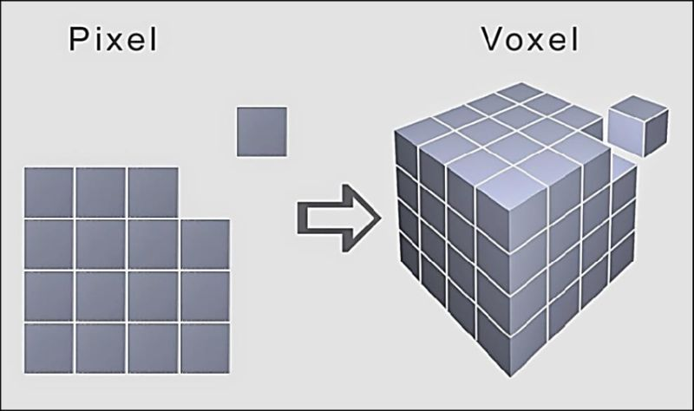
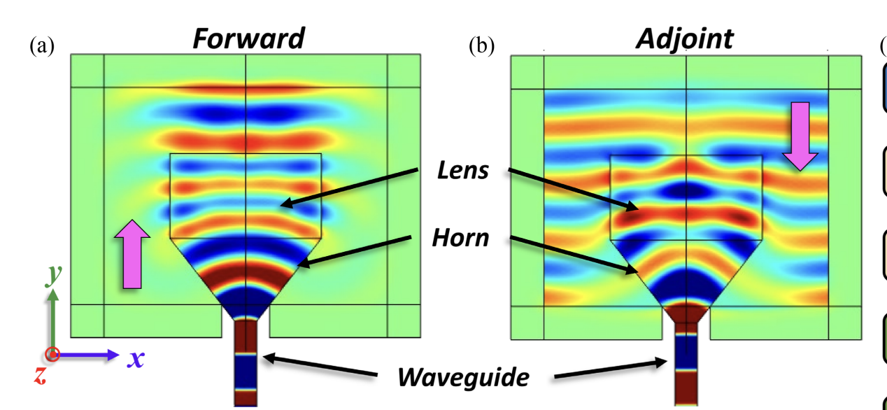
Adjoint Sensitivity Optimization of Three-Dimensional Directivity-Enhancing, Size-Reducing GRIN Lenses
How do voxels change an object?
  Tweak voxel
  Re-run simulation
  Repeat for each voxel (thousands of simulations end up being run)
How are GRIN lens designed?
  Instead of TO GRIN lenses can be designed using Adjoint Optimization
  Adjoint Optimization uses only two simulations to see how each voxel changes
  Forward Simulation
    Antenna is turned on
    Waves pass though the lens
    Measure the gain of the beam
  Adjoint Simulation
    Its flipped
    A virtual electromagnetic is wave toward the antenna
      (in direction we want to maximize gain)
E. B. Whiting et al., "Adjoint Sensitivity Optimization of Three-Dimensional Directivity-Enhancing, Size-Reducing GRIN Lenses," in IEEE Antennas and Wireless Propagation Letters, vol. 21, no. 11, pp. 2166-2170, Nov. 2022, doi: 10.1109/LAWP.2022.3182900.
keywords: {Lenses;Permittivity;Optimization;Three-dimensional displays;Gain;Electric fields;Computational modeling;Additive manufacturing;gradient optimization;gradient Index (GRIN);inverse design},

Slide 9
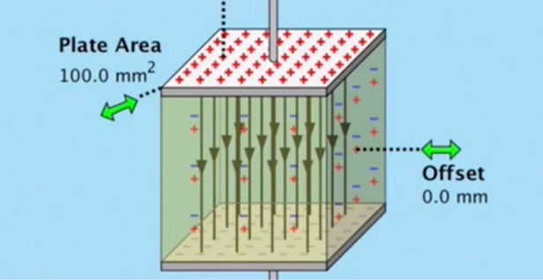
Adjoint Sensitivity Optimization of Three-Dimensional Directivity-Enhancing, Size-Reducing GRIN Lenses
Gradient
  By multiplying the forward field x adjoint field you get the gradient
    Forward field is the actual radiated field (Volts/Meter)
    Adjoint field is the backward propagating field (Volts/Meter)
Permittivity
  Positive gradient -> Increase permittivity here
  Negative gradient -> Decrease permittivity here
  Near Zero gradient -> No change needed here
  More dielectric material = higher permittivity
  You decrease the permittivity by adding more air (voids)
Permittivity describes how a material responds to a electric field
    High permittivity -> electromagnetic waves travel slower through the material
    Low permittivity -> waves travel faster through the material
E. B. Whiting et al., "Adjoint Sensitivity Optimization of Three-Dimensional Directivity-Enhancing, Size-Reducing GRIN Lenses," in IEEE Antennas and Wireless Propagation Letters, vol. 21, no. 11, pp. 2166-2170, Nov. 2022, doi: 10.1109/LAWP.2022.3182900.
keywords: {Lenses;Permittivity;Optimization;Three-dimensional displays;Gain;Electric fields;Computational modeling;Additive manufacturing;gradient optimization;gradient Index (GRIN);inverse design},

Slide 10
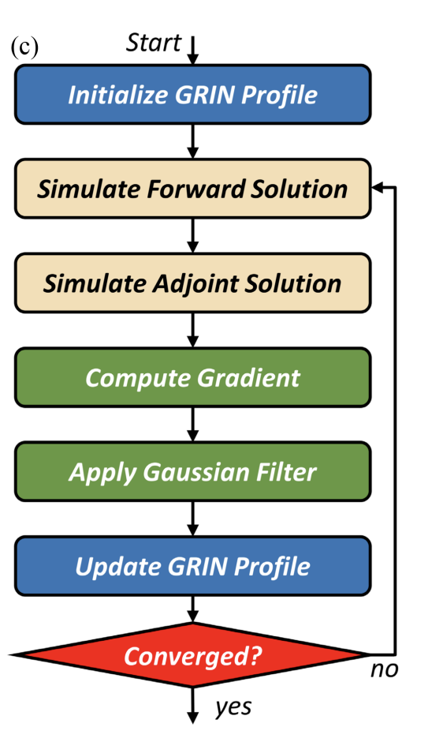
Adjoint Sensitivity Optimization of Three-Dimensional Directivity-Enhancing, Size-Reducing GRIN Lenses
Optimization Loop (the algorithm)
  Start with initial GRIN lens profile (starting permittivity values for each voxel)
  Run Forward Simulation
  Run Adjoint Simulation
  *(Both simulations are run on COMSOL Multiphysics)
  Solve for gradient of each voxel
  Apply a gaussian filter (replaces each voxel value with weighted average of its neighbors)
    Closer voxels influence it more
    Further out voxels influence it less
  Apply permittivity bounds
    if any values are outside the allowable permittivity range, set them to the maximum or minimum allowable value
  Repeat the optimization loop until the gain stops improving
  (gain is evaluated during each iteration of the forward simulation)
E. B. Whiting et al., "Adjoint Sensitivity Optimization of Three-Dimensional Directivity-Enhancing, Size-Reducing GRIN Lenses," in IEEE Antennas and Wireless Propagation Letters, vol. 21, no. 11, pp. 2166-2170, Nov. 2022, doi: 10.1109/LAWP.2022.3182900.
keywords: {Lenses;Permittivity;Optimization;Three-dimensional displays;Gain;Electric fields;Computational modeling;Additive manufacturing;gradient optimization;gradient Index (GRIN);inverse design},

Slide 11
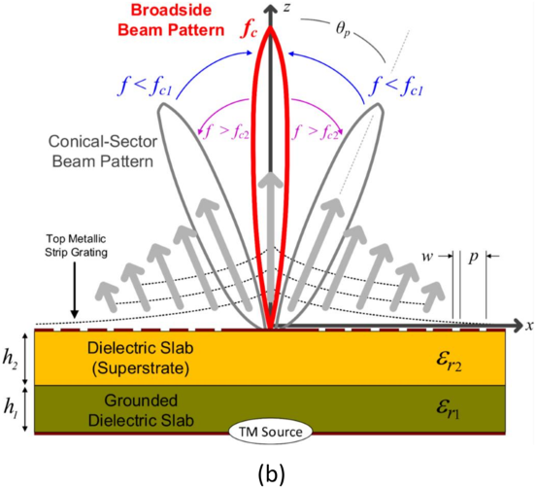
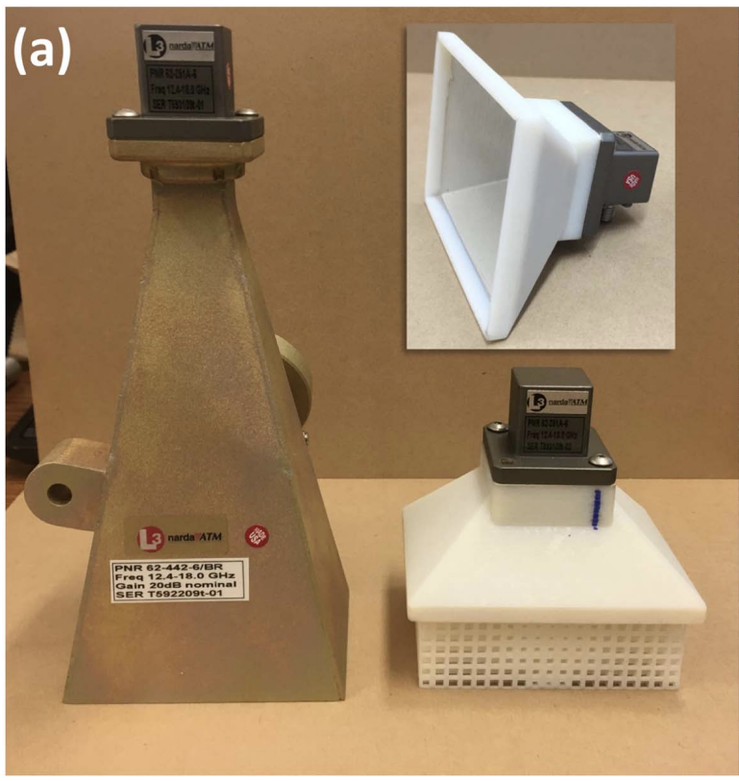
Adjoint Sensitivity Optimization of Three-Dimensional Directivity-Enhancing, Size-Reducing GRIN Lenses
What is being Optimized?
  The gain (strength) of the broadside beam is being maximized
  The antenna should be able to send as much power possible straight forward at the 0 degree angle
Design & Result
  GRIN Lens was printed using Stratasys 3D printer in plastic material
  Printed different size holes within each voxel
  (allows control over how much air enters each voxel)
  Result was a horn that was 60% smaller and 40% lighter
E. B. Whiting et al., "Adjoint Sensitivity Optimization of Three-Dimensional Directivity-Enhancing, Size-Reducing GRIN Lenses," in IEEE Antennas and Wireless Propagation Letters, vol. 21, no. 11, pp. 2166-2170, Nov. 2022, doi: 10.1109/LAWP.2022.3182900.
keywords: {Lenses;Permittivity;Optimization;Three-dimensional displays;Gain;Electric fields;Computational modeling;Additive manufacturing;gradient optimization;gradient Index (GRIN);inverse design},

Slide 12
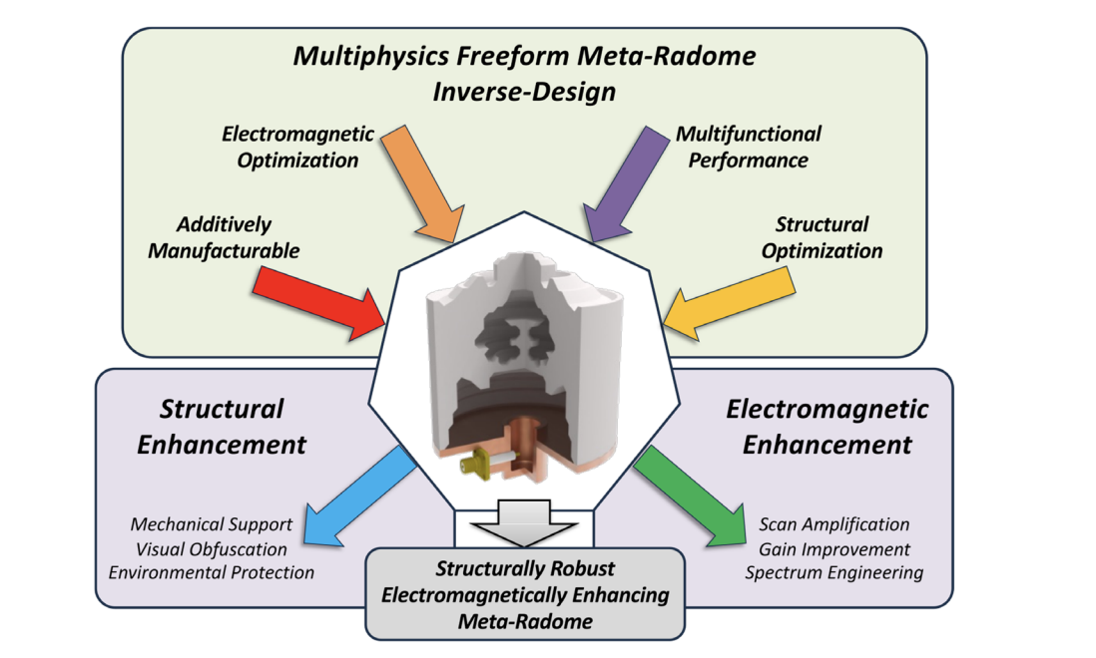
Multiphysics Inverse-Design of Multifunctional Freeform Meta-Radomes
General Notes
A radome is a cover that protects an antenna against environmental conditions
Goal is to design a meta-radome that:
  Improves antenna gain
  Is easily manufacturable
  Can survive 4400N mechanical load
Multiphysics Optimization is used (involves concepts from EM & mechanical design)
Burns, Tyler & Huynh, Andy & Mackertich‐Sengerdy, Galestan & Campbell, Sawyer & Werner, Douglas. (2025). Multiphysics Inverse‐Design of Multifunctional Freeform Meta‐Radomes. Small Structures. 6. 10.1002/sstr.202500397.

Slide 13
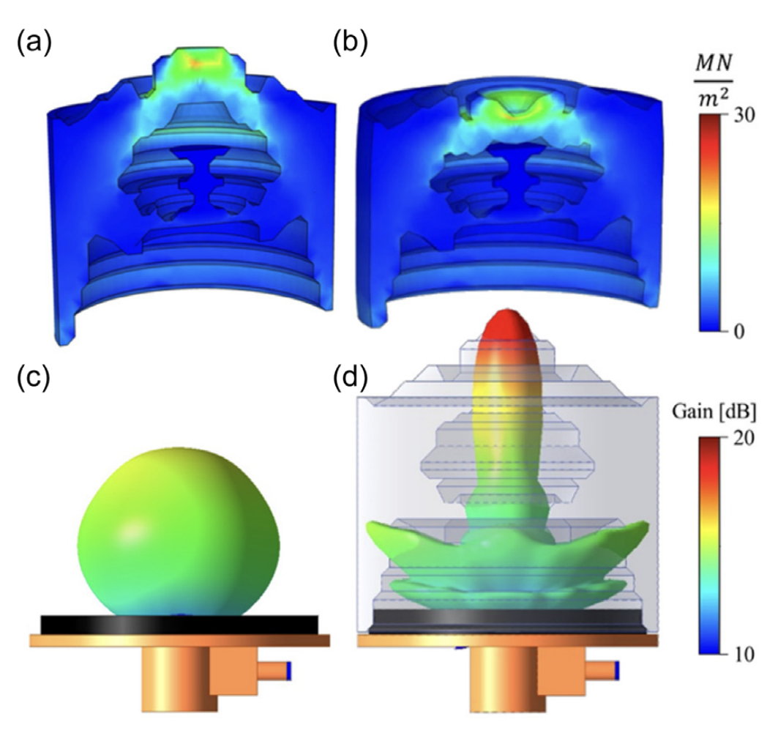
Multiphysics Inverse-Design of Multifunctional Freeform Meta-Radomes
Electromagnetic Optimization
Goal is to maximize gain coming from the broadside beam (image d)
Adjoint optimization
(same technique used for Grin Lenses)
  Convert design into voxels
  Run Forward Simulation (provides gain, this shows how antenna is currently preforming)
  Run Adjoint Simulation (inject wave at 0 degrees since broadside beam is where we want to maximize gain)
  Solve gradient (forward field x adjoint field)
    Positive gradient -> add more material (increase permittivity)
    Negative gradient -> Decrease permittivity

Slide 14
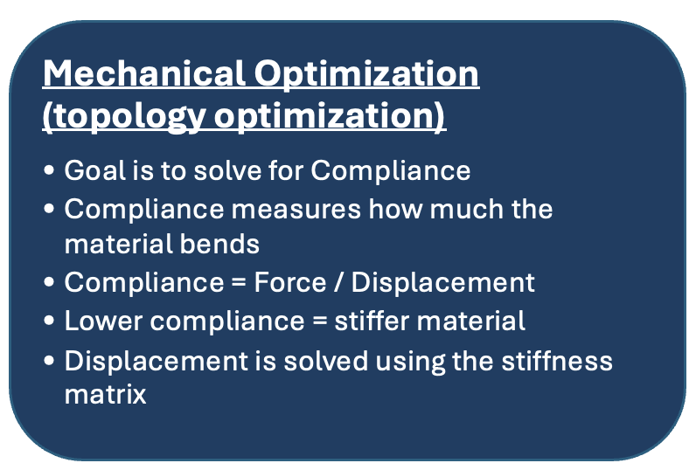
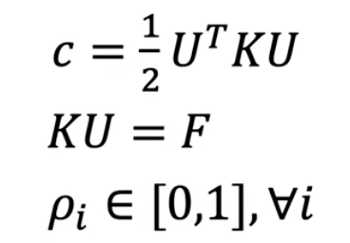
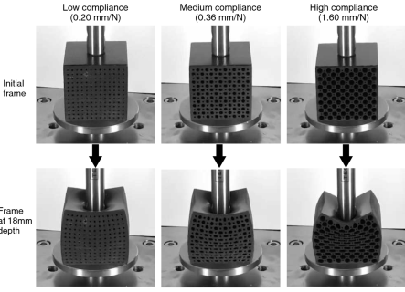
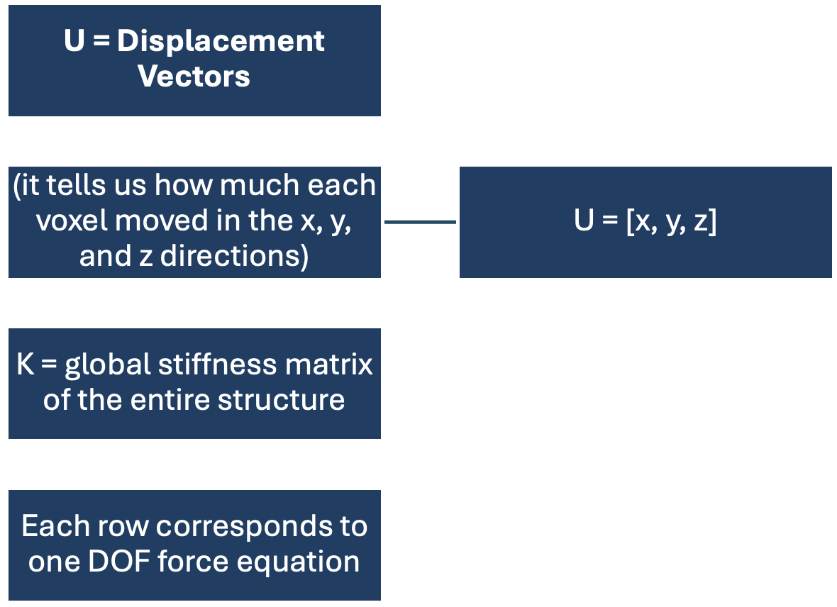
Multiphysics Inverse-Design of Multifunctional Freeform Meta-Radomes

Slide 15
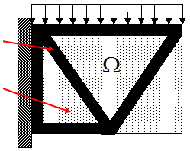

Multiphysics Inverse-Design of Multifunctional Freeform Meta-Radomes
SIMP model
The stiffness of each voxel is expressed using:
$K_{E}$= ${\text{ρ}}^{p}KE$
$K_{E}$= Stiffness of each voxel
$KE$= Stiffness of the solid material
ρ = density (0 to 1)
p = penalization factor
Penalization factor (p) : it makes intermediate (half) density voxels preform poorly so that during optimization they are pushed to either be fully solid or empty.
Density (ρ) ↑⇒ Elasticity of each voxel (E)↑⇒ Stiffness (k) ↑⇒ Displacement (x) ↓⇒ Compliance(C)↓

Slide 16
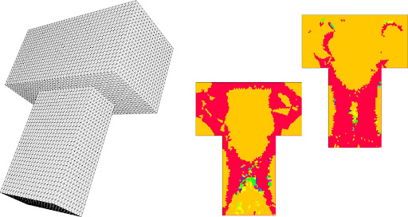
Multiphysics Inverse-Design of Multifunctional Freeform Meta-Radomes
The SIMP model (Solid Isotropic Material with Penalization)
  The material is divided into many voxels
  Each voxel has density value (ρ) between 0 and 1
  ρ = 0 void (no material)
  ρ = 1 (solid)
The voxels in red are the “removed” material; their density was driven to zero during the SIMP optimization process.
SIMP model

Slide 17

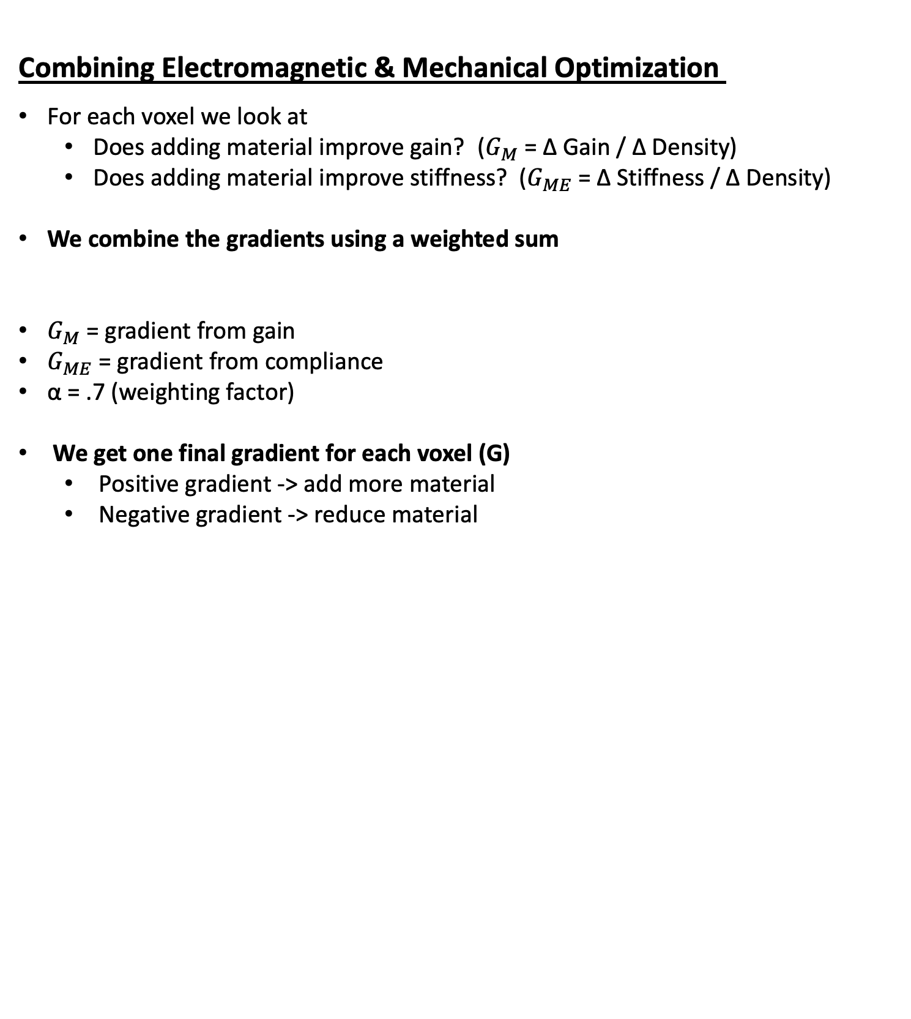
Multiphysics Inverse-Design of Multifunctional Freeform Meta-Radomes
Combining Electromagnetic & Mechanical Optimization
For each voxel we look at
  Does adding material improve gain? ($G_{M}$ = ∆ Gain / ∆ Density)
  Does adding material improve stiffness? ($G_{ME}$ = ∆ Stiffness / ∆ Density)
We combine the gradients using a weighted sum
$G_{M}$ = gradient from gain
$G_{ME}$ = gradient from compliance
α = .7 (weighting factor)
We get one final gradient for each voxel (G)
  Positive gradient -> add more material
  Negative gradient -> reduce material

Slide 18
Adjoint Sensitivity Optimization of Three-Dimensional Directivity-Enhancing, Size-Reducing GRIN Lenses
Optimization Loop (the algorithm)
Run forward EM simulation
Run adjoint EM simulation
Run mechanical simulation
Compute gradients
Combine gradients
Update voxel densities
*This whole process took about 7 minutes to generate a design
We keep running this optimization loop until the gain no longer increases and the compliance no longer significantly decreases. This tells us that we have converged to a local optimum.
E. B. Whiting et al., "Adjoint Sensitivity Optimization of Three-Dimensional Directivity-Enhancing, Size-Reducing GRIN Lenses," in IEEE Antennas and Wireless Propagation Letters, vol. 21, no. 11, pp. 2166-2170, Nov. 2022, doi: 10.1109/LAWP.2022.3182900.
keywords: {Lenses;Permittivity;Optimization;Three-dimensional displays;Gain;Electric fields;Computational modeling;Additive manufacturing;gradient optimization;gradient Index (GRIN);inverse design},

Slide 19
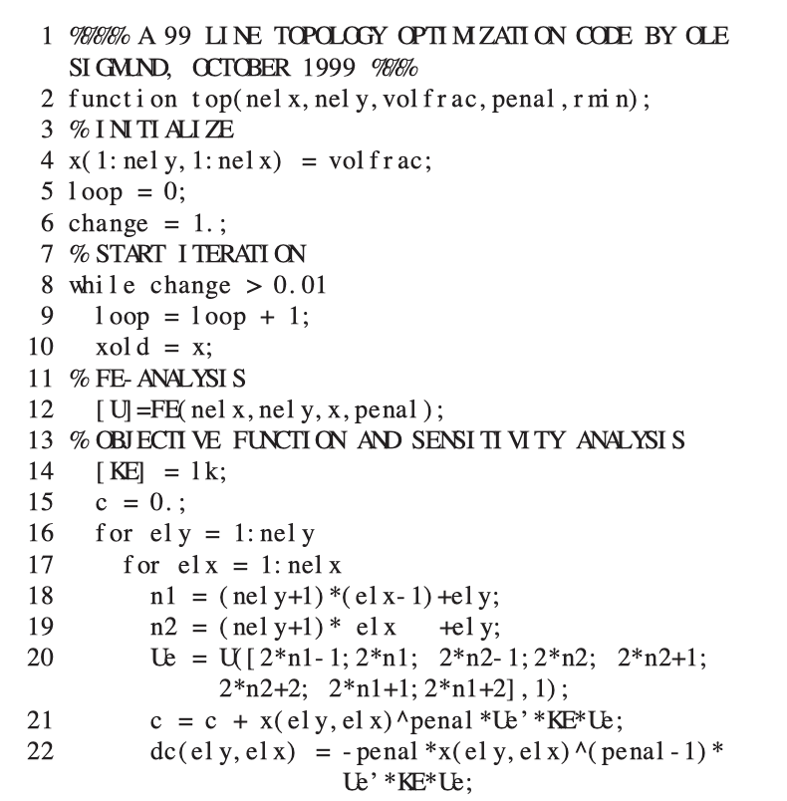
A 99 line topology optimization code written in Matlab
99 - Line Topology Optimization Code
This is the original minimal MATLAB code written by Ole Sigmund (2001)
Solves the problem “Where should you place material to make a structure as stiff as possible (given a fixed amount of material)?”
Used for 2-D Optimization
88-Line Version (Vectorized, Faster)
Provides the same result as the 99 line version
10x -100x faster to run
Can handle larger objects

Slide 20
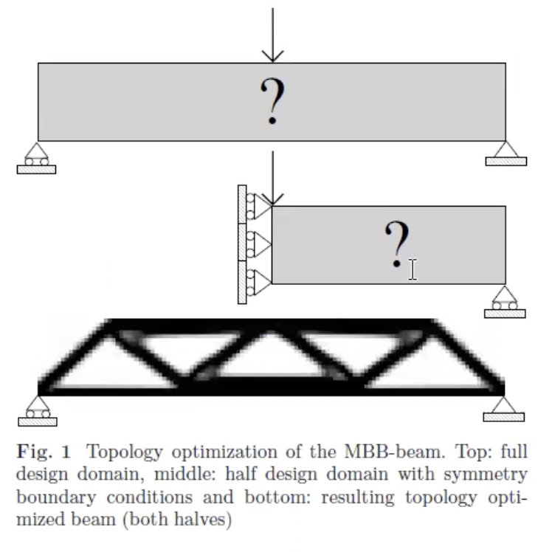
A 99 line topology optimization code written in Matlab
The optimization process
Starts with a block of material
Applies loads and supports
Uses Finite Element Analysis to solve for deformation
Solves for which areas carry stress
Gets rid of inefficient material
This loop runs until you get an optimized shape
99 - Line Topology Optimization Code
Main Sections
Input parameters
Initialize design variables
Optimization loop
Finite Element Analysis
Sensitivity Analyisis
Filtering

Slide 21
A 99 line topology optimization code written in Matlab
function top(nelx,nely,volfrac,penal,rmin)
First step is to create a function that takes 5 input parameters
Design grid size = nelx * nely
  nelx: number of elements in the x direction
  nely: number of elements in the y direction
Volume Fraction Constant (volfrac)
  Tells you how much of the design grid can have material
  Ex. volfrac =.5, if we have 1000 elements only 500 elements worth of material is allowed
Penalization factor (usually 3): forces design to become solid (1) or void (0)
Rmin: Radius used for the filter (replaces each element's value with the weighted average of its neighbors)
  Ex. Rmin = 1.5, each element is influenced by others within radius of 1.5 elements

Slide 22
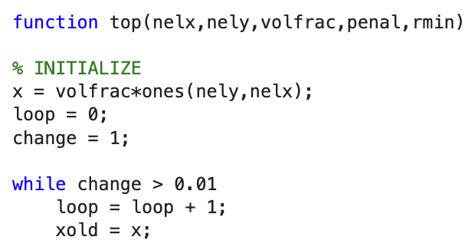
A 99 line topology optimization code written in Matlab
Initialize design variables
Tell the optimizer that all elements start with the same density
  x = volfrac * ones(nely,nelx);
Set the optimization loop to run until the design stops changing significantly
  while change > 0.01
  loop = loop + 1;
  xold = x;

Slide 23
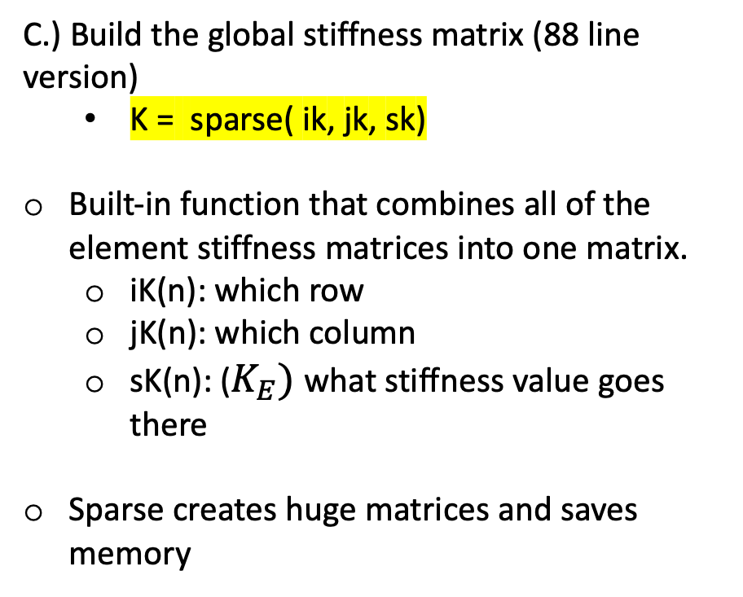
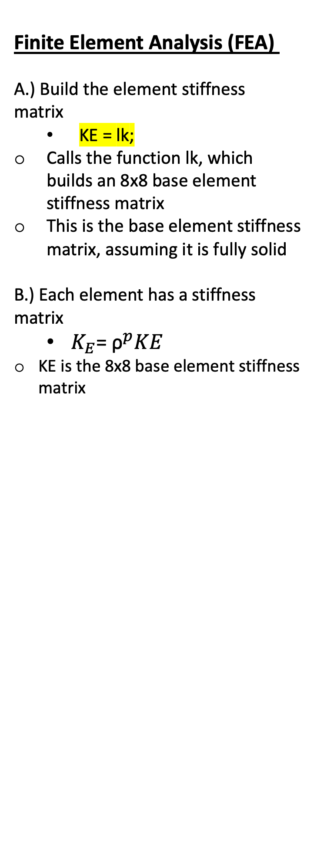
A 99 line topology optimization code written in Matlab
Finite Element Analysis (FEA)
A.) Build the element stiffness matrix
  KE = lk;
Calls the function lk, which builds an 8x8 base element stiffness matrix
This is the base element stiffness matrix, assuming it is fully solid
B.) Each element has a stiffness matrix
  $K_{E}\text{= }{\text{ρ}}^{p}KE$
KE is the 8x8 base element stiffness matrix
C.) Build the global stiffness matrix (88 line version)
  K = sparse( ik, jk, sk)
Built-in function that combines all of the element stiffness matrices into one matrix.
  iK(n): which row
  jK(n): which column
  sK(n): ($K_{E})$ what stiffness value goes there
Sparse creates huge matrices and saves memory

Slide 24
A 99 line topology optimization code written in Matlab
Finite Element Analysis (FEA)
D.) Solve for displacement matrix U
(gives you the displacement vector of each node)
U(freedofs) = K(freedofs,freedofs) \ F(freedofs);
Originally, we had the global stiffness matrix for the entire design grid.
Now, we only keep the matrix corresponding to the degrees of freedom that are free.
We set its size to: Size = (# free DOFs) × (# free DOFs), so that we can extract a smaller matrix from the full global stiffness matrix K.
With F(freedofs), we take our force vector and reduce it down to only the entries corresponding to the free degrees of freedom.

Slide 25
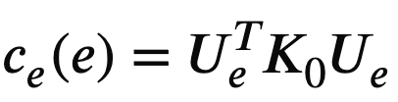
A 99 line topology optimization code written in Matlab
Compliance
A.) Solve for the compliance of each element and use that to find the total compliance of the structure
ce = sum((U(edofMat)*KE).*U(edofMat),2)
KE: base element stiffness matrix
edofMat = (number of elements) * 8, each element has 8 DOF corresponding to it
U(edofMat): Takes all the rows listed in edofMat
U((edofMat),2): Takes rows listed in edofMat, but only from column 2.
  Ex. edofMat is 1200 × 8
B.) Solve for the total compliance of the entire structure
c = sum(sum((x.^penal).*ce));
c.) Solve for the gradient of compliance with respect to density
dc = -penal * x.^(penal-1) .* ce;
Positive gradient -> add more material
Negative gradient -> reduce material

